Slide 1
Quantum Computing Architectures (EE274) Lecture 20
Hiu-Yung Wong
apr. 10, 2025
hiuyung.wong@sjsu.edu, Office: ENG363
http://www.sjsu.edu/people/hiuyung.wong/index.html

Slide 2
Outline
Josephson Junction
Circuit Quantization

Slide 3
Announcement

Slide 4
Superconducting Device
Chapter 16 of “Quantum Computing Architecture and Hardware for Engineers: Step by Step”

Slide 5
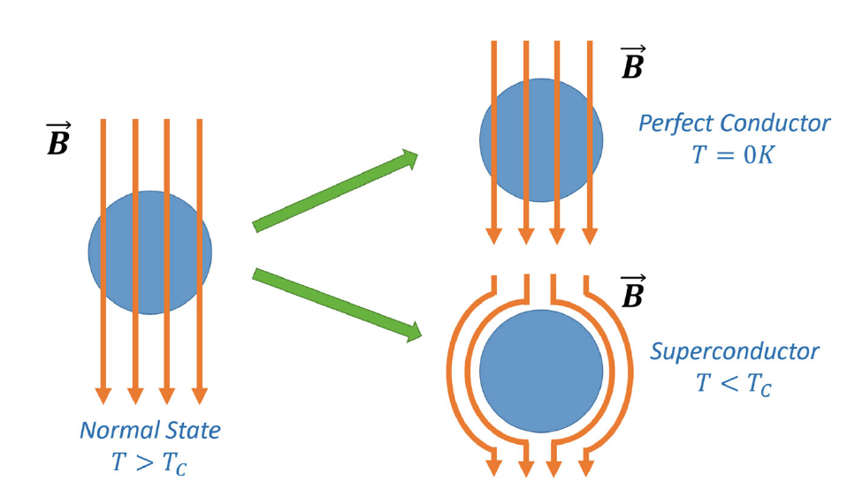
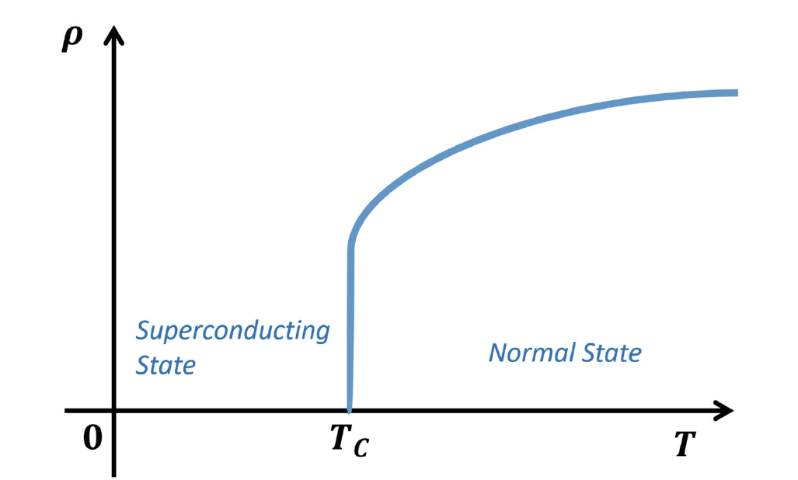
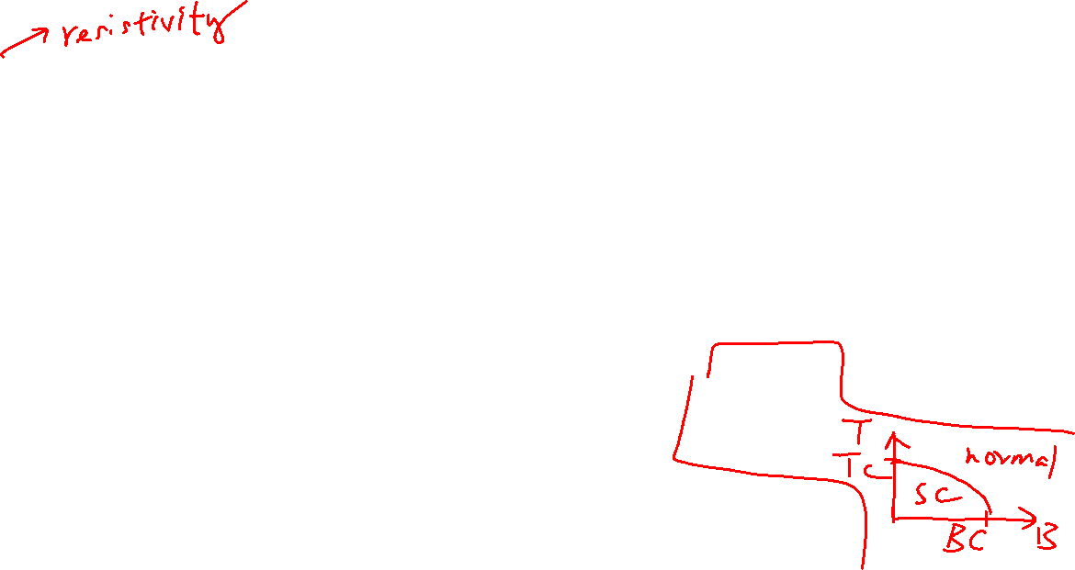
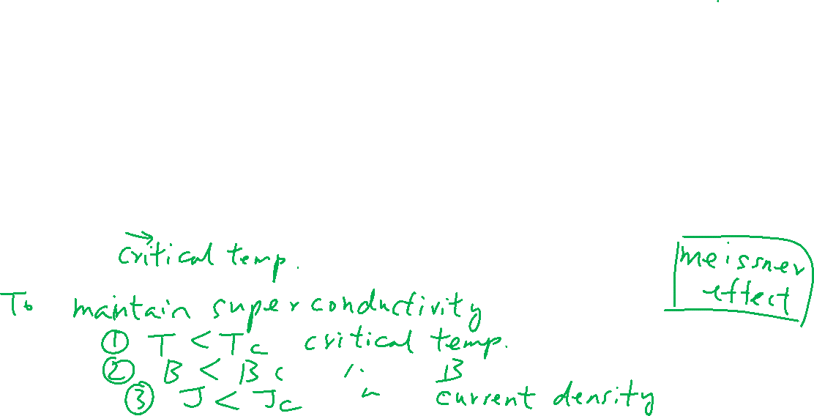
Superconductors
Learning outcomes: Difference between superconductor and perfect conductor

Slide 6
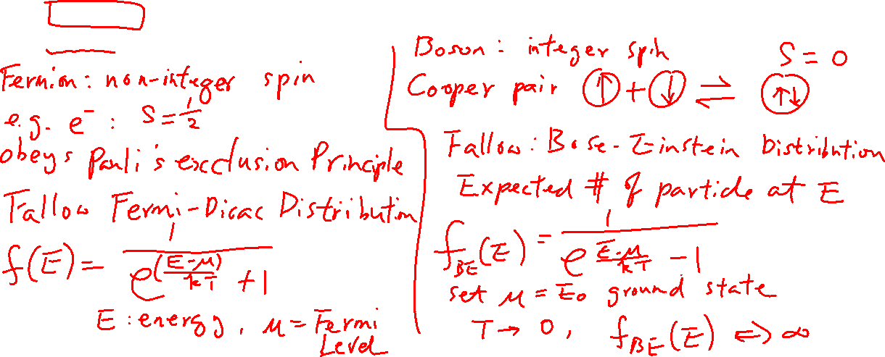
BCS Theory and Cooper Pair
Learning outcomes: Understand the nature of cooper pairs
Bardeen, Cooper, Schrieffer
Cooper pair: bound states of 2 electrons with opposite spin and momentum (mediated by phonon)
Spin zero: Follow Bose Einstein Statistics

Slide 7
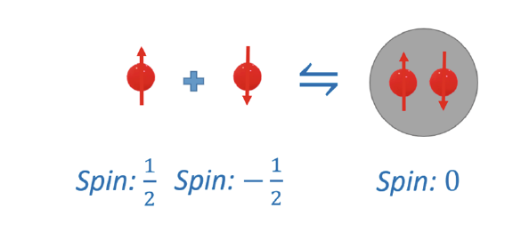
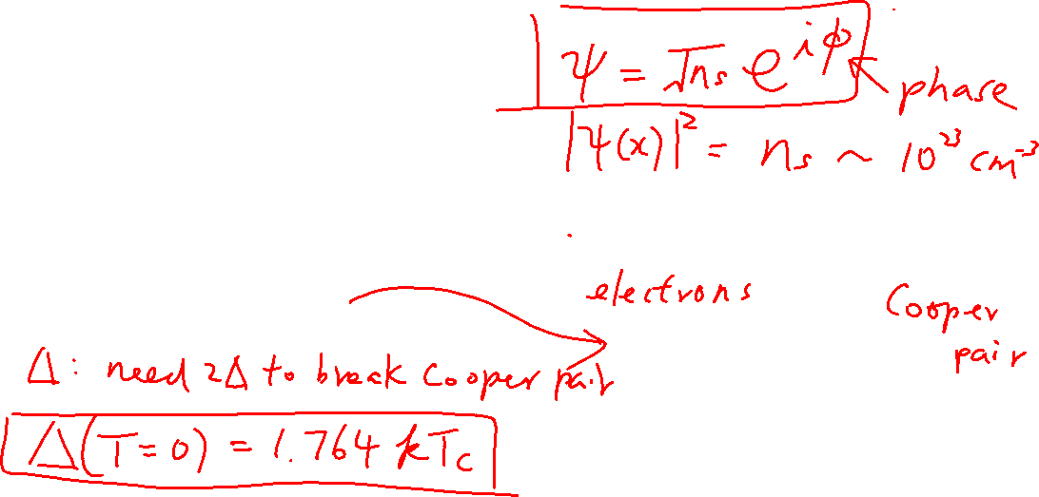
Cooper Pair
Learning outcomes: Understand the nature of cooper pairs
Described by the same wavefunction
A macroscopic quantum object
Gap Energy and QuasiParticles

Slide 8
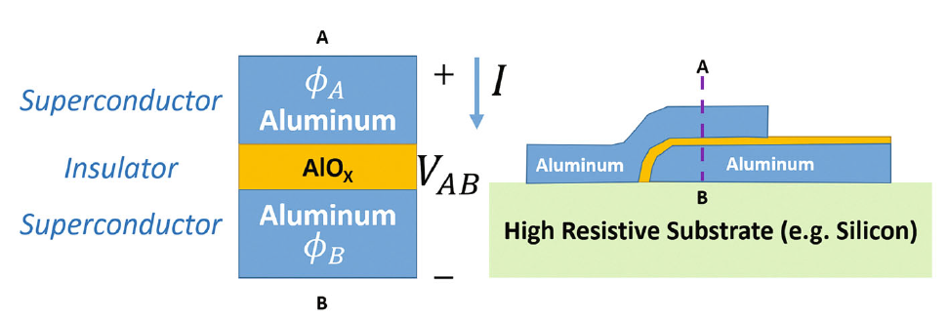
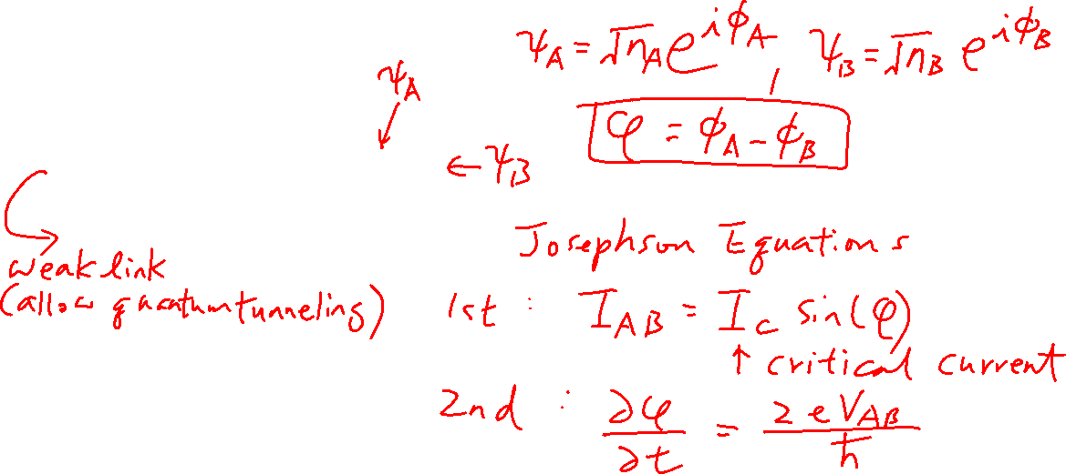
Josephson Junction and Josephson Equations
Learning outcomes: Difference between superconductor and perfect conductor

Slide 9
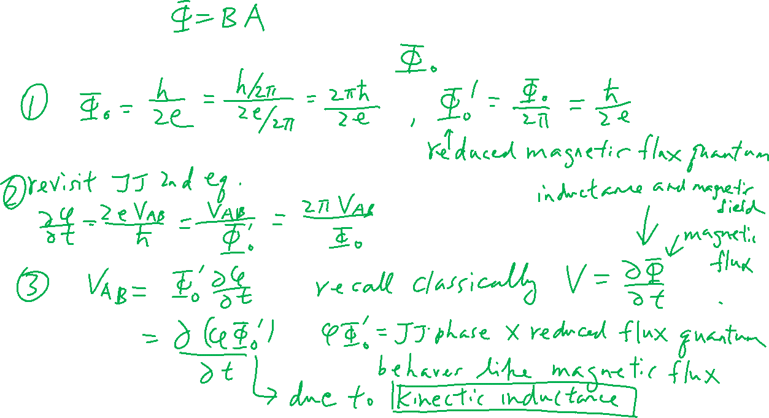
Magnetic Flux Quantum

Slide 10
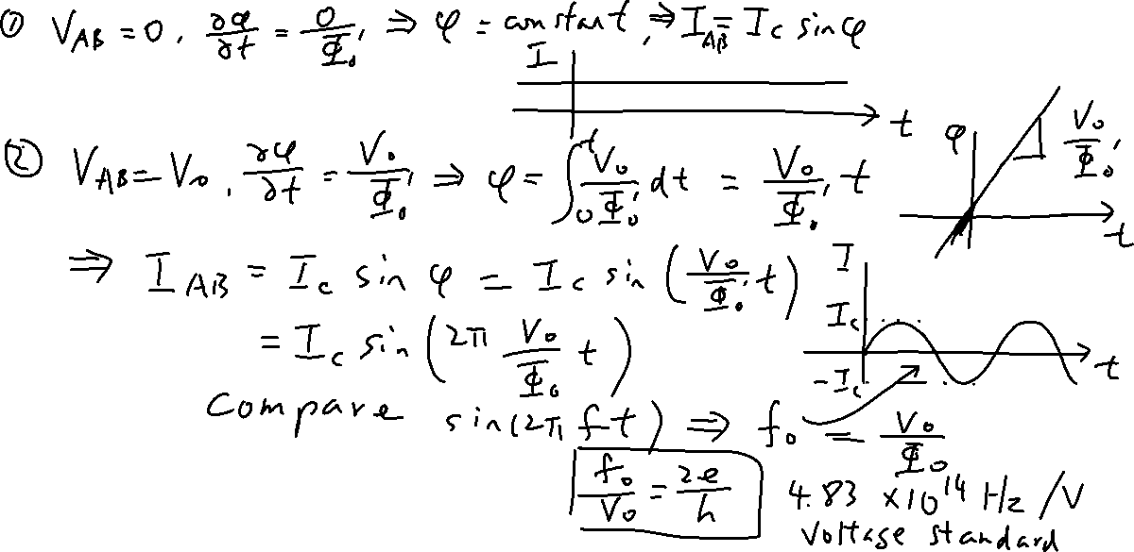
JJ Equations
Learning outcomes: Origin of Josephson voltage standard; I-V relationship in JJ

Slide 11
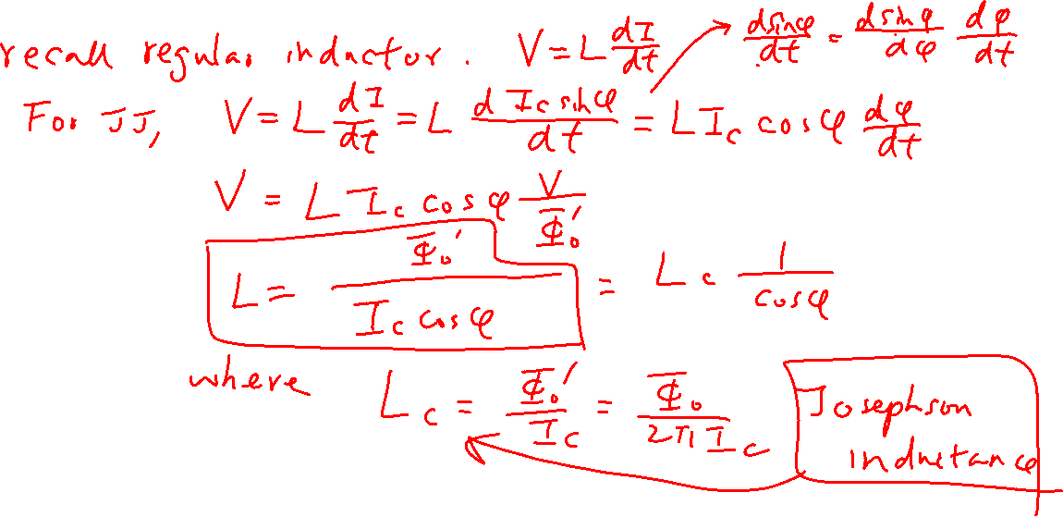
Josephson Inductance
Learning outcomes: JJ inductance is non-linear and due to the kinetic energy of the Cooper pairs

Slide 12
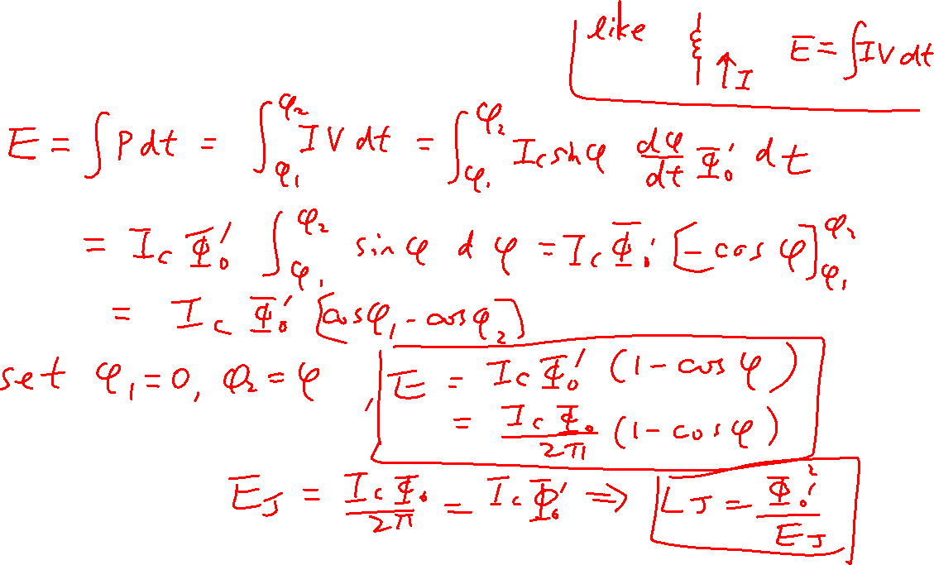
Josephson Energy

Slide 13
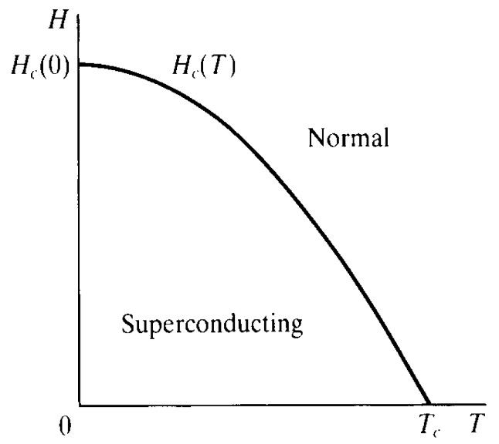
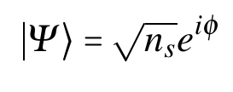

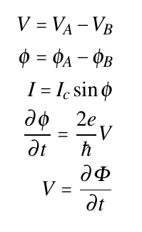
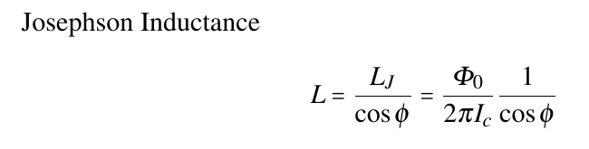

Summary
Superconductor: zero resistivity + Meissner Effect
Characteristics: T_{C}, H_{C}, J_{C}
Copper pairs:
2 electrons with opposite spin and momentum
Bosons
Macroscopic quantum object,
Josephson Junction
Tinkham
Superconductor (A)
Insulator
Superconductor (B)

